Slide 1
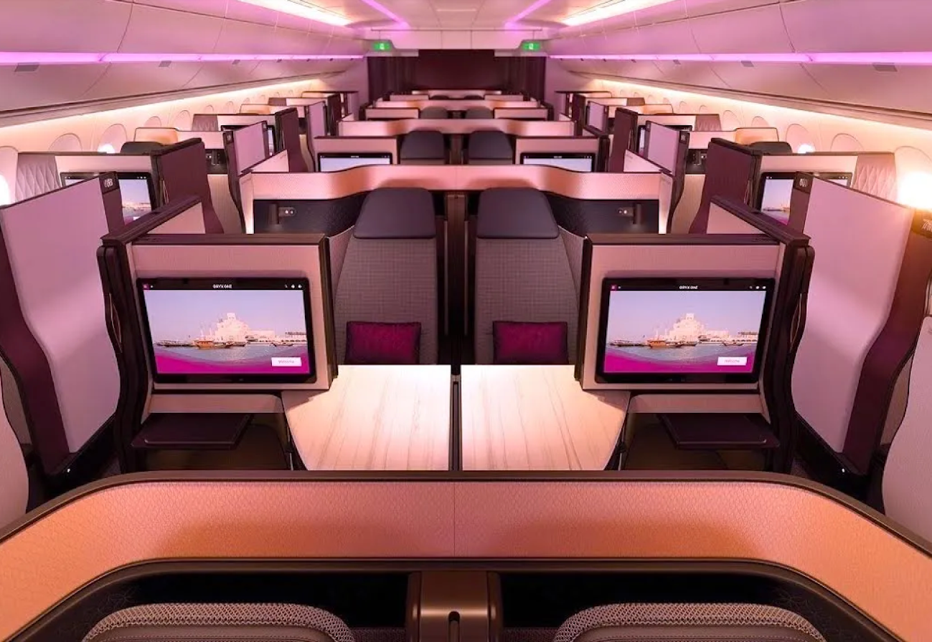
Flying First Class with ABC Airline
Group S:
Anandita Maurya
Divi Joshi
Roshaan Mahmood
Yikang Lu

Slide 2
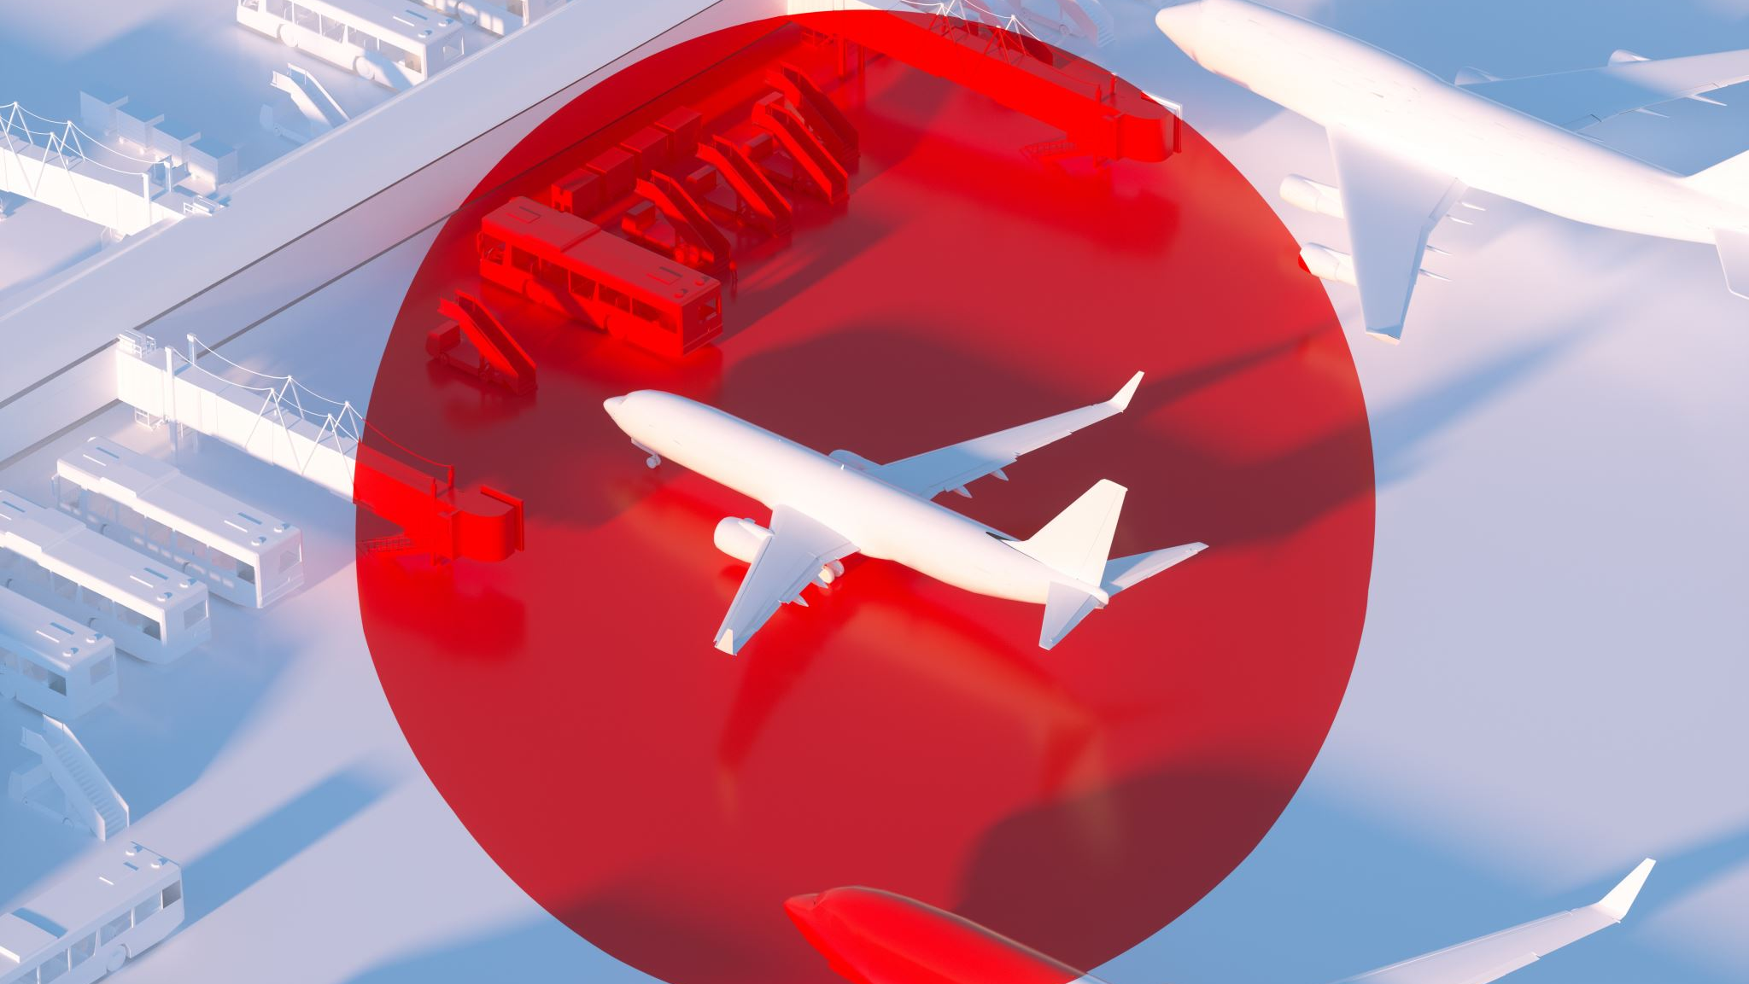
Business Problem
Understand the satisfaction levels of passengers flying in the business class of ABC airline
Identify ways to improve the travel experience for business class passengers.

Slide 3
Objective
Identify areas where ABC airline can make improvements to increase overall satisfaction levels amongst their passengers.

Slide 4
Methodology
ABC airline has collected 4999 unsatisfied reviews from their passengers on 14 service aspects on a scale of 0-5
1 being the lowest rating, 5 is highest satisfaction and 0 means "not applicable"
A Segmentation analysis on these 4999 reviews is conducted through Enginius
The segmentation analysis will group passengers based on their satisfaction levels across the 14 service aspects

Slide 5
Segmentation Variables
Departure and Arrival Time Convenience
Ease of Online Booking
Check-in Service
Online Boarding
Gate Location
On-board Service
Seat Comfort
Leg Room Service
Cleanliness
Food and Drink
In-flight Service
In-flight Wifi Service
In-flight Entertainment
Baggage Handling

Slide 6
Descriptor Variables
ID
Gender
Age
Customer Type (First time / Returning)
Type of Travel (Business/Personal)

Slide 7
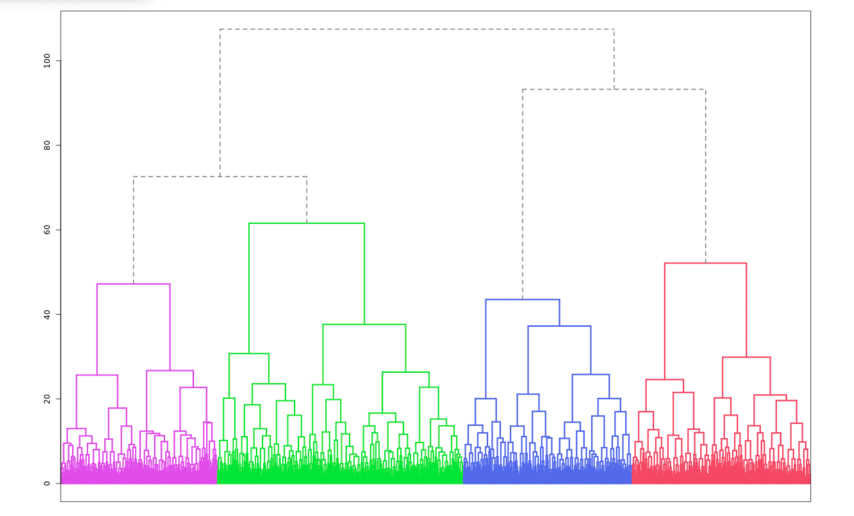
Dendogram
Notes:
As the number of observations is too large to perform hierarchical clustering, Enginius used Kmeans instead on the dataset.

Slide 8
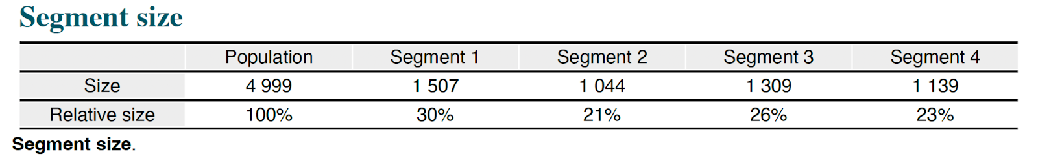
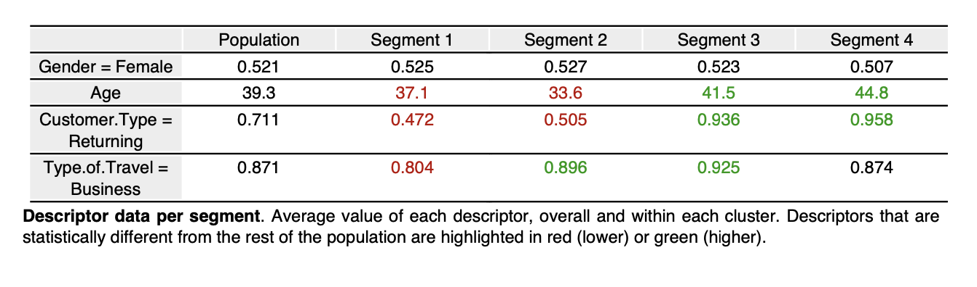
Description of the Clusters
Notes:
As the number of observations is too large to perform hierarchical clustering, Enginius used Kmeans instead on the dataset.

Slide 9
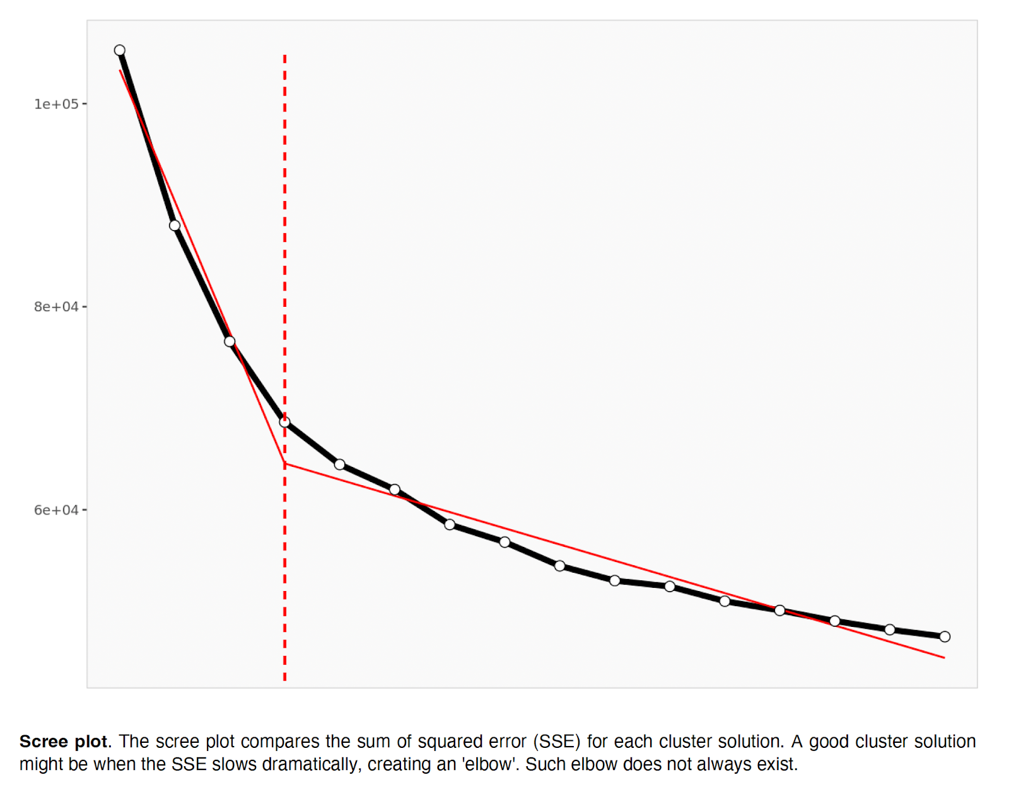
Scree Plot

Slide 10
Segment 1: “Younger Leisure Flyers”
30% of individuals are young adults
Average age of 37
47% of these 30% are returning flyers, suggesting that most of them are first time fliers with ABC airline
Individuals in this segment tend to be flying for personal reasons.
Highly satisfied with in-flight services.
Expressed slight concerns regarding
Ease of online ticket booking
Convenience of gate location
Departure-arrival times.

Slide 11
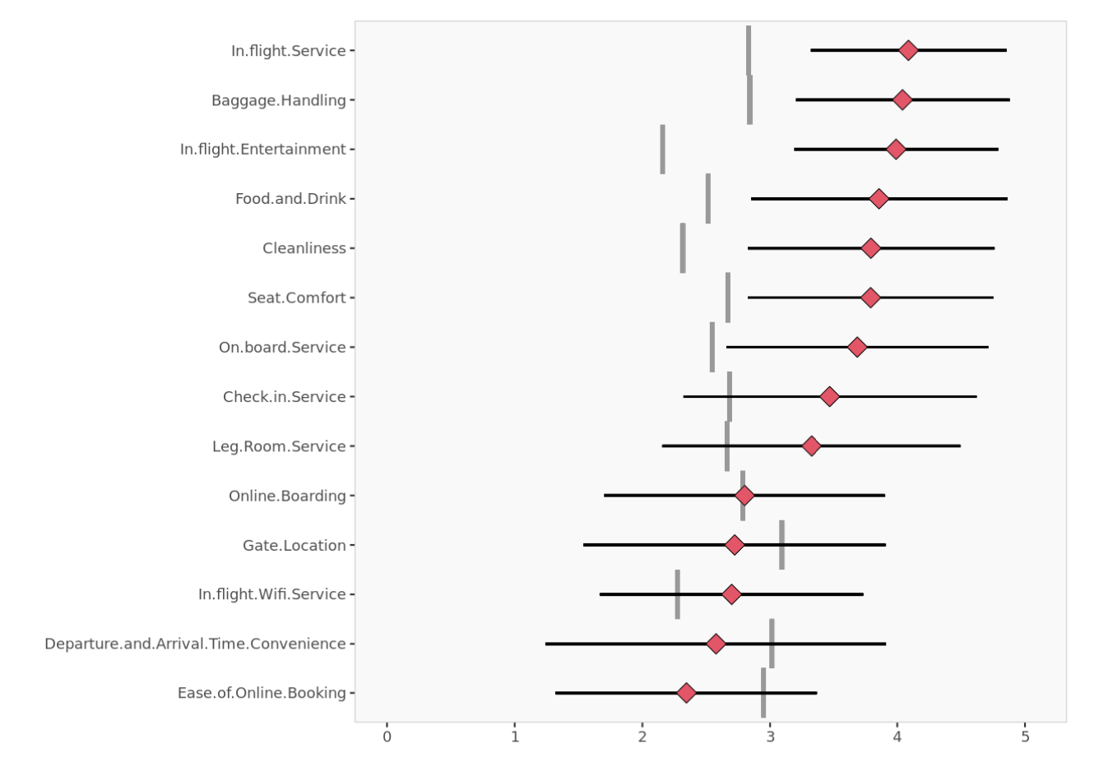
Segment 1: “Younger Leisure Flyers”
Notes:
As the number of observations is too large to perform hierarchical clustering, Enginius used Kmeans instead on the dataset.

Slide 12
Segment 2: “Younger Professional Flyers”
21% of individuals within this specific group are young adults
An average age of 34.
51% of these are returning flyers
Individuals within this segment tend to fly for business purposes.
Highly satisfied with
The in-flight service
Baggage handling services
Did not have a positive experience with
Seat comfort,
Cleanliness,
Food & drinks,
And in-flight entertainment.

Slide 13
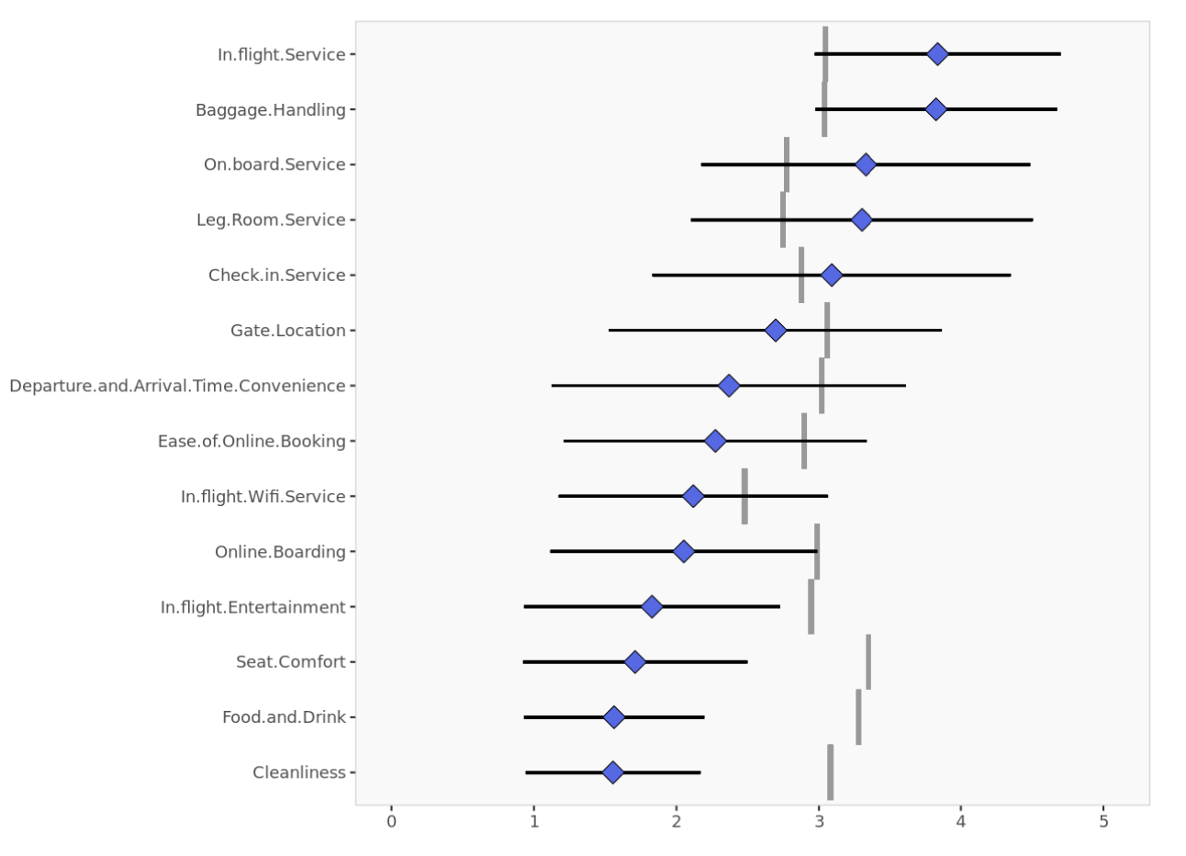
Segment 2: “Younger Professional Flyers”
Notes:
As the number of observations is too large to perform hierarchical clustering, Enginius used Kmeans instead on the dataset.

Slide 14
Segment 3: "Middle-aged Executive Flyers"
26% of individuals fall into the middle-aged adult category
An average age of 42
94% are returning flyers
A higher percentage of individuals who are flying for business purposes.
High levels of satisfaction with
Ease of online booking,
The convenience of gate location,
And departure-arrival times
Expressed slight concerns with
Baggage handling
In-flight service.

Slide 15
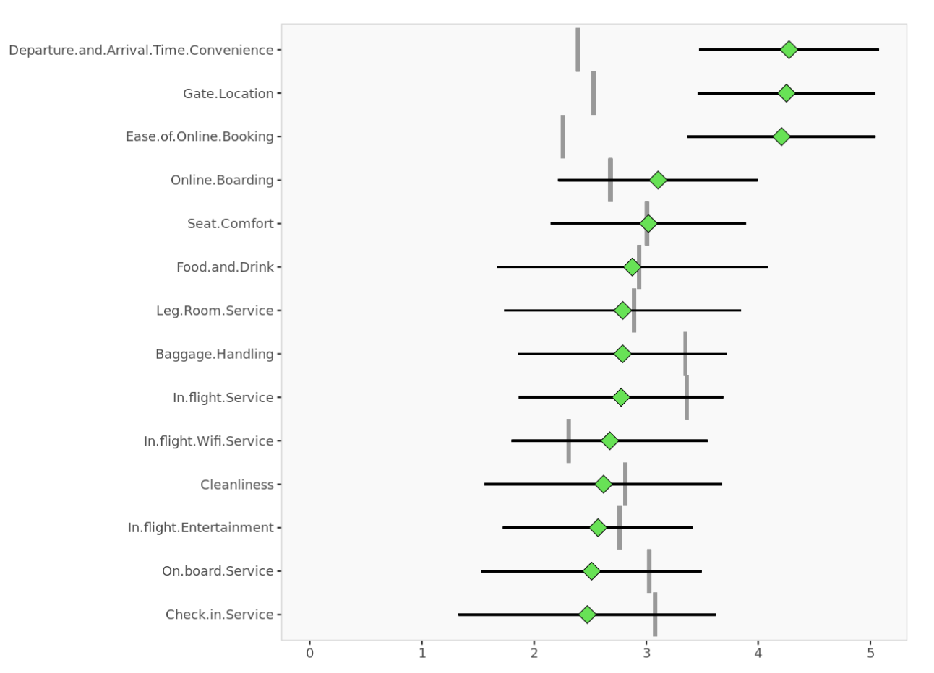
Segment 3: "Middle-aged Executive Flyers"
Notes:
As the number of observations is too large to perform hierarchical clustering, Enginius used Kmeans instead on the dataset.

Slide 16
Segment 4: “Loyal Business Travelers”
23% of individuals
An average age of 45
96% are returning flyers
87% of individuals are flying for business purposes
Reported lower satisfaction with
Baggage handling,
In-flight and onboarding services,
Available leg room

Slide 17
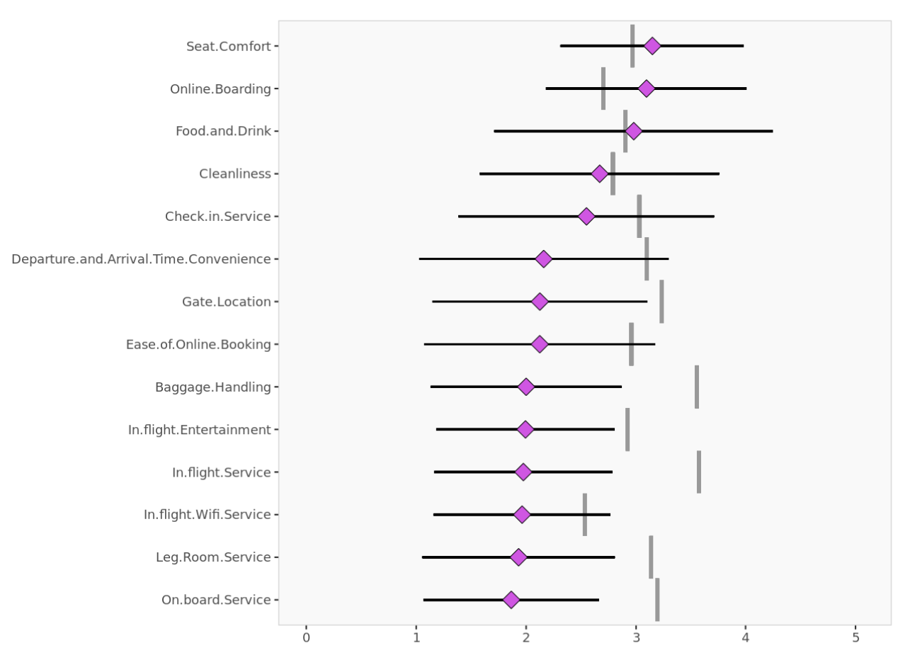
Segment 4: “Loyal Business Travelers”
Notes:
As the number of observations is too large to perform hierarchical clustering, Enginius used Kmeans instead on the dataset.

Slide 18
Managerial Conclusion
Improve the ease of online booking by collaborating with ticket booking websites
Optimizing their own website through SEO
Increase their online visibility by incorporating relevant keywords,
Investing in paid search ads will improve the user experience and make it easier for customers to book flights.
To address concerns regarding inflight service and cleanliness, ABC airline should consider increasing the training time and quality for their air crew, as well as improving their system of rewards and penalties.
By prioritizing the customer experience both before and during the flight, ABC airline can improve customer satisfaction and loyalty.

Slide 19
Future Scope
Since the original dataset was not designed for segmentation analysis, the hit rate of the model is low at 44%.
A higher hit rate can be achieved if more variables are introduced by means of a survey which are inclined towards studying the segmentation variables from the respondents.
To solve this problem, in our future analysis, we can separate the variables into prior-. during-, and after-flight services and use the linear probability model to predict the percentage change of the satisfaction level by modifying different services.
In this case, we can help the airline understand how to improve their services in another way.

Slide 20
Thank You

